Slide 1
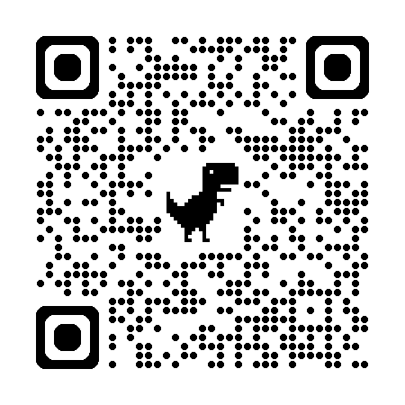
Attendance Sign In Required
TEXT Event ID to 972-573-8343
or log in and enter at cme.utsouthwestern.edu/code
to Sign in for this session. The Event ID is available today only. You will receive a message confirming your attendance.
To meet the Office of Continuing Education requirements, ALL participants must sign in, regardless of whether CME/CE credit is being claimed.
Notes:
Replace <Event ID> with the unique code for this session

