Slide 2
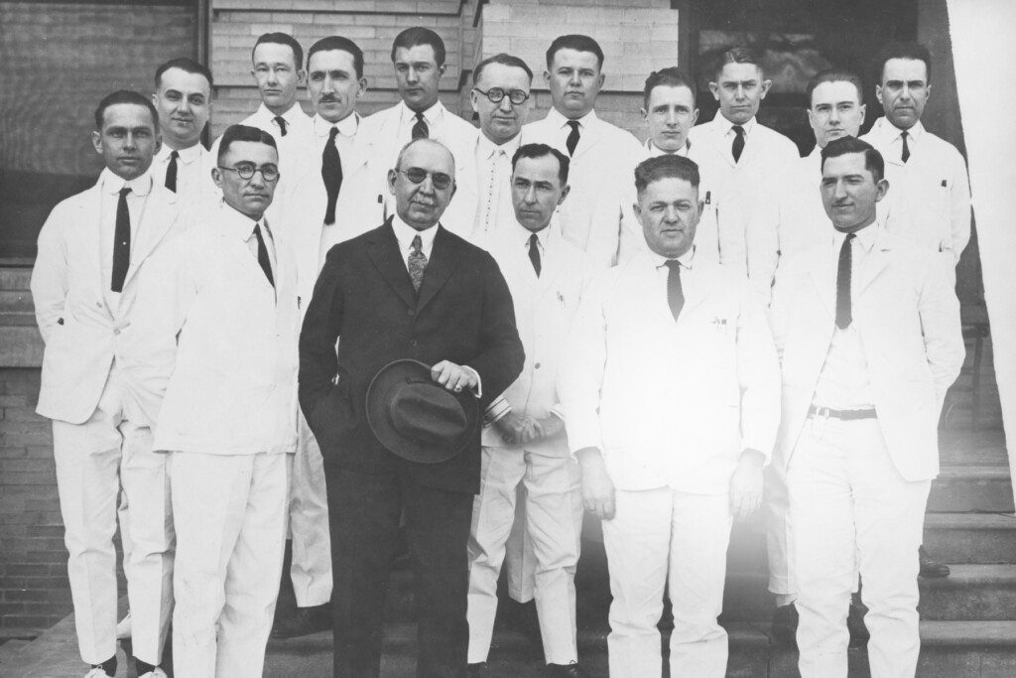
Edward Henry (E.H.) Cary MD
Medical Grand Rounds : UT Southwestern 1 May 2026

Slide 4
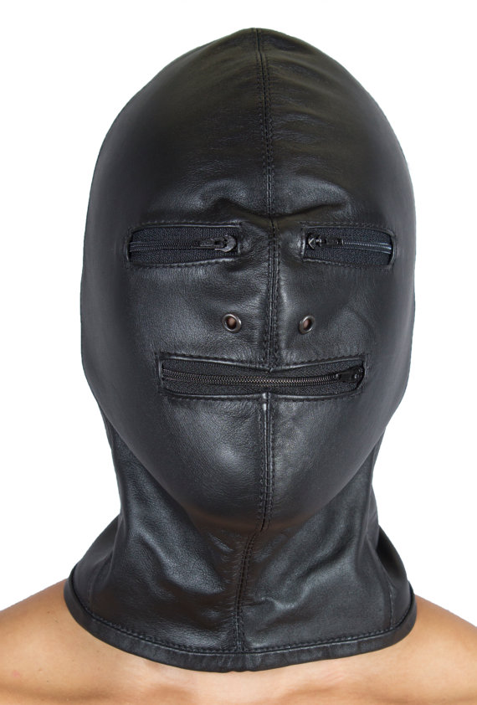

Scott
The Fernald School
aka the “Experimental School for Teaching and Training Idiotic Children”
Founded 1848
Eugenics
50% residents had normal IQ
HU-MIT research
Scott Allen. “The Voice of a Lost Generation”,
_{The Boston Globe May 2, 2006}
Notes:
Oldest publicly funded institution for persons with developmental disabilities

Slide 5

Scott
“No one tried to listen to me then, but now, I finally have a voice…”
Scott Allen. “The Voice of a Lost Generation”,
_{The Boston Globe May 2, 2006}

Slide 6



Beth
“I think that it’s time to transition…”
… for the past 25 years, no one ever asked me to …

Slide 7
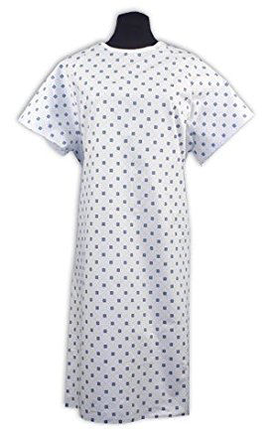
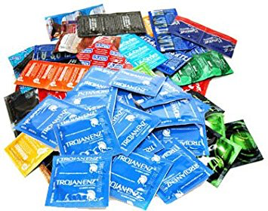
x
Richard
35 yo Truncus w ED

Slide 8

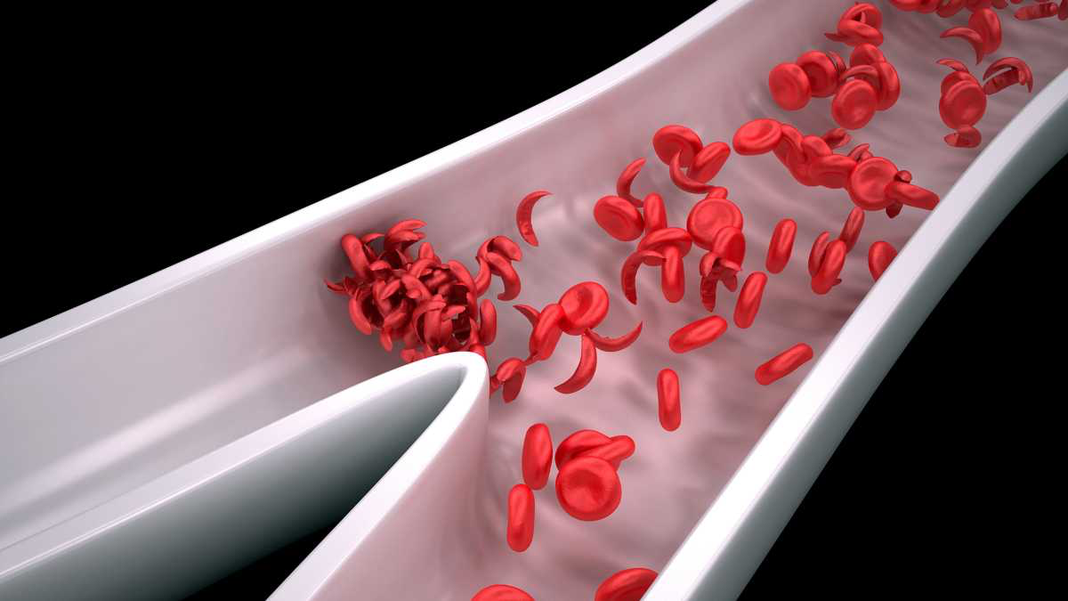
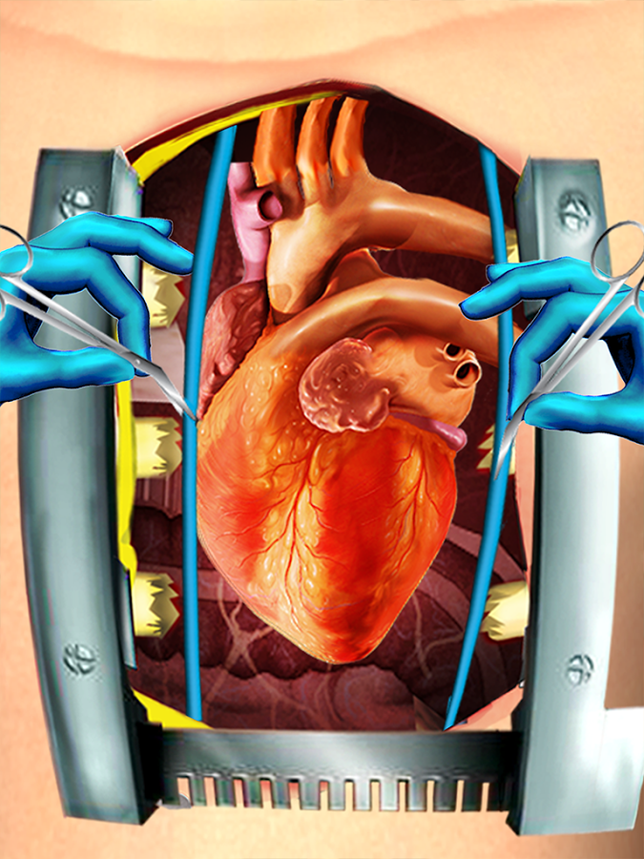

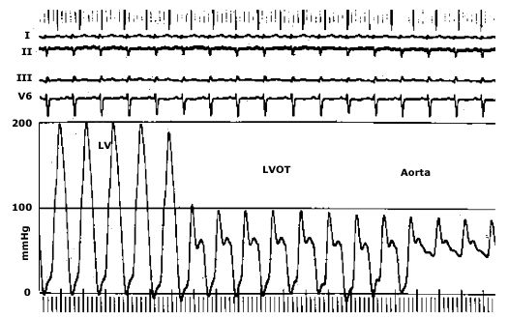

John

Slide 9
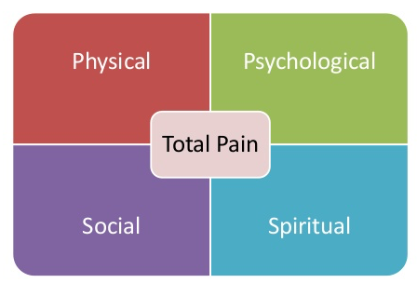
Functional capacity
Fatigue, cachexia, sleep
Dyspnea, cough, CP
Appetite, nausea
Thirst
Apprehension, worries
Grief, depression
Anxiety, fear, anger
Pleasures, leisure
Cognitive function
SUFFERING
Family relationships
Loss of role, status
Capacity to give/receive Financial, insurance
Dependency
Guilt, remorse
Finding meaning
Understanding value
Anger at fate, God
Fear of the unknown

Slide 10



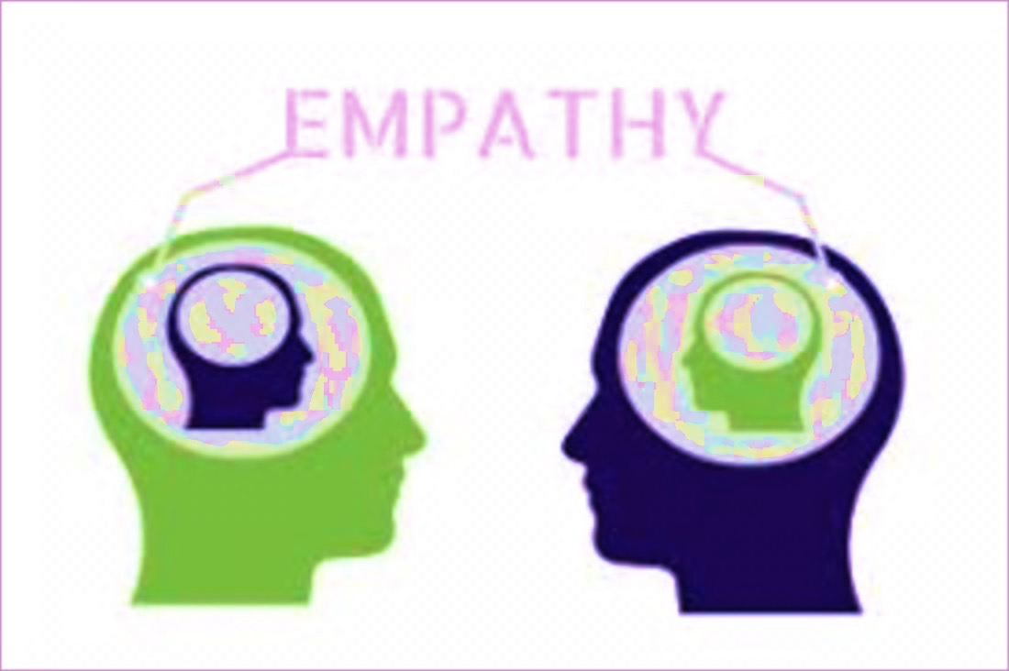
Lessons from the Science and Practice of
Michael J. Landzberg, MD BACH Cardiology (and Heart Pal Care) Staff
Medical Grand Rounds: UT Southwestern 1 May 2026

Slide 11
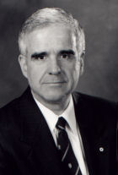
Objectives:
To identify sociological, spiritual, and philosophical examples of relationalism
To describe the affective, cognitive and behavioral components of empathy, and their critical synergy
To contrast empathy, sympathy and compassion (and the risks that such present to care providers) within the clinician-patient relationship

Slide 12
I have no relationships with any industry pertaining to this presentation

Slide 13

Jong, Erica (1973). Fear of Flying. New York: Berkley
Notes:
1973, Erica Jong
For its own therapeutic sake
Without ulterior motive
Without commitment
Without emotional involvement
Between 2 prevously unaquainted individuals

Slide 14
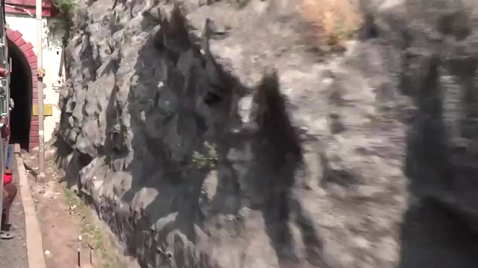
Notes:
1973, Erica Jong
For its own therapeutic sake
Without ulterior motive
Without commitment
Without emotional involvement
Between 2 prevously unaquainted individuals

Slide 15
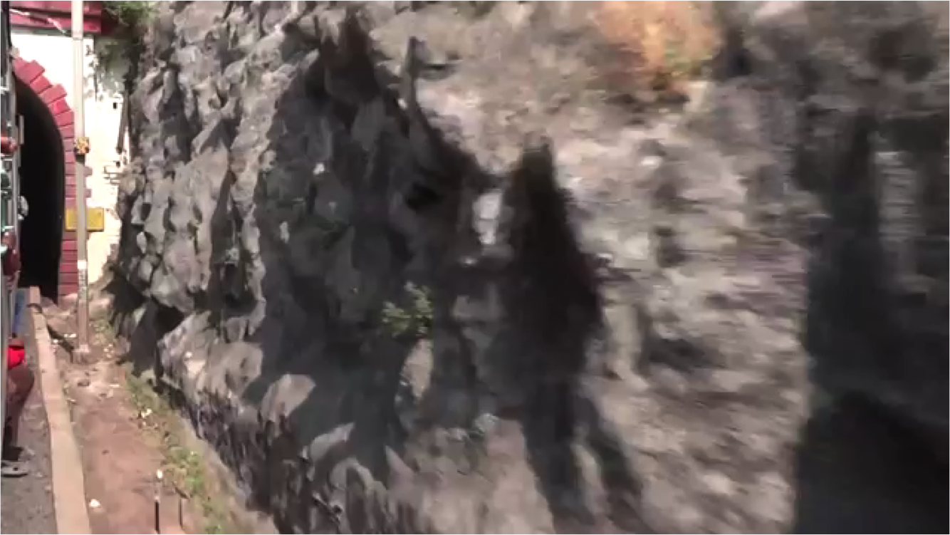
A relationship that is unbounded
for its own therapeutic sake
without ulterior motive
without commitment
without emotional involvement
between 2 previously unacquainted parties

Slide 16
Objectives:
To identify sociological, spiritual, and philosophical examples of relationalism
To describe the affective, cognitive and behavioral components of empathy, and their critical synergy
To contrast empathy, sympathy and compassion (and the risks that such present to care providers) within the clinician-patient relationship

Slide 17

ALIGNMENT is a central component
in the clinician-patient-family bond
Sawubona
Ngikhona
I see you
I exist
Notes:
Zulu
Yebo Sawubona (Yes, we see you too)

Slide 18
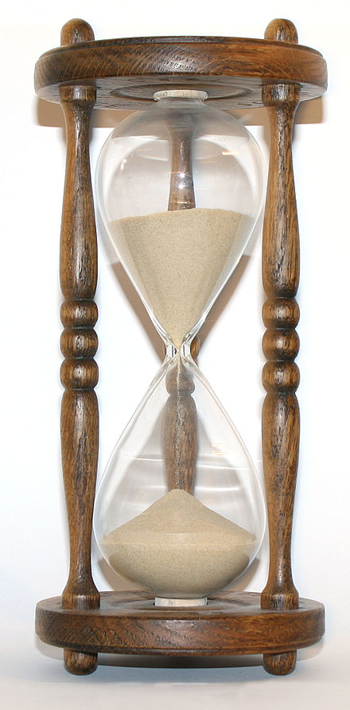
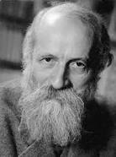
Martin Buber
Martin Buber
(in < 5 minutes)

Slide 19
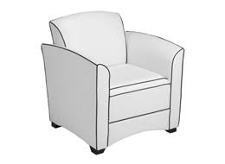
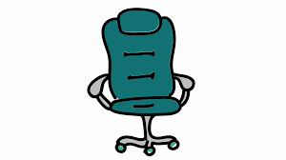


Plato’s “forms” are the foundation for relationalism

Slide 20

Plato’s “forms” are the foundation for relationalism

Slide 21
Aristotle relates fulfillment (telos) via “hylomorphism”

Slide 22
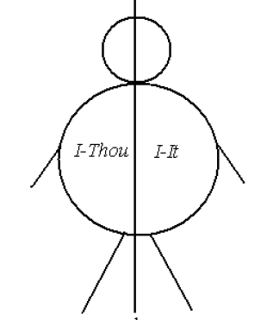



Buber: we relate to nature, people and the eternal

Slide 23
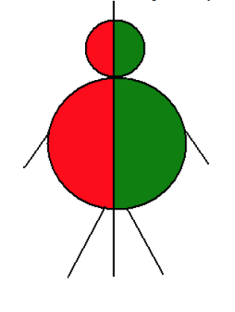
Buber: Our relationships are two-fold in nature
I IT
I THOU

Slide 24
Buber: Our relationships are two-fold in nature
I IT
I THOU

Slide 25
Buber: Our relationships are two-fold in nature
To some “thing”
Bounded
Governed by past experience
Manipulative
Never with the whole being
To no “thing”
Unbounded
In the present
Un-egoistic
Locus of growth
Always with the whole being
I IT
I THOU

Slide 26
We are defined by the totality of our relationships
I IT
I THOU
I
I
EXISTENCE

Slide 27
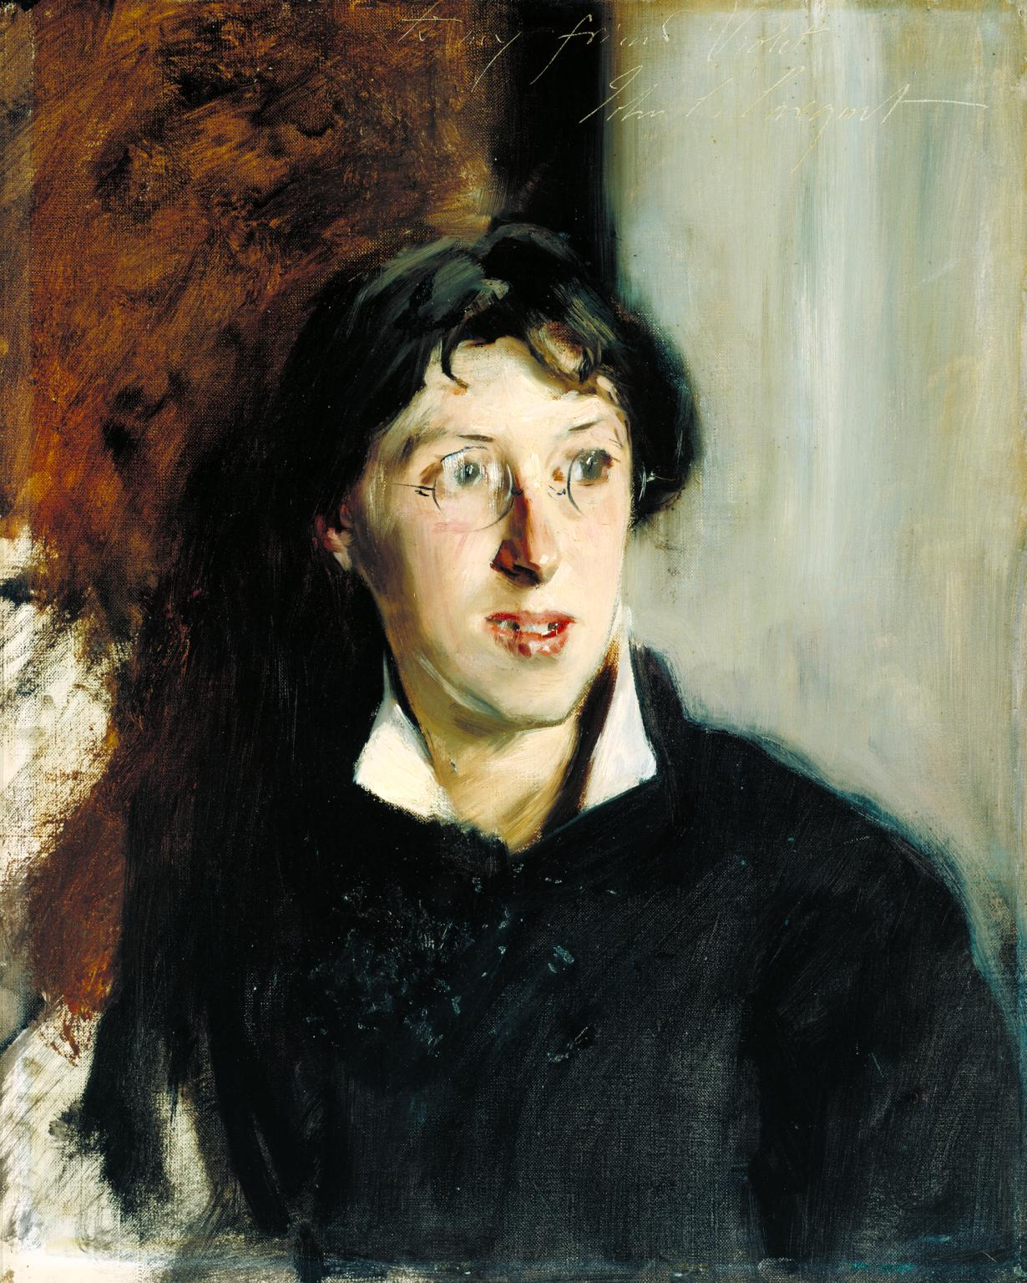
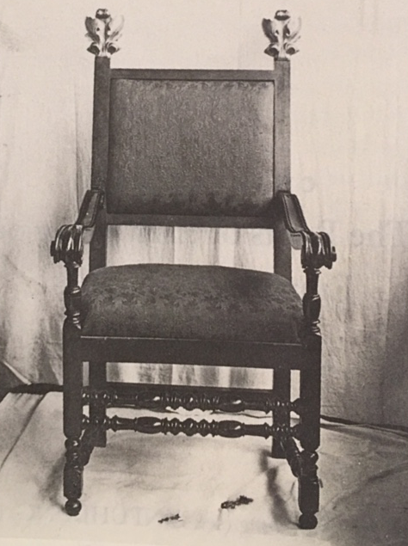
Aesthetics
John Singer Sargent. Portrait of Vernon Lee. 1881
Colby College Special Collections,
Waterville, ME

Slide 28
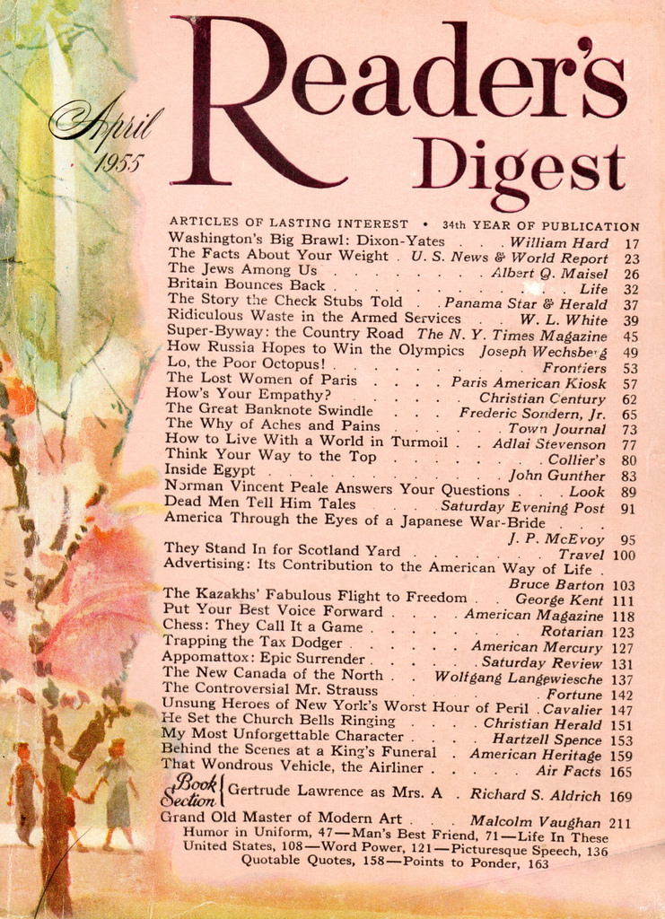
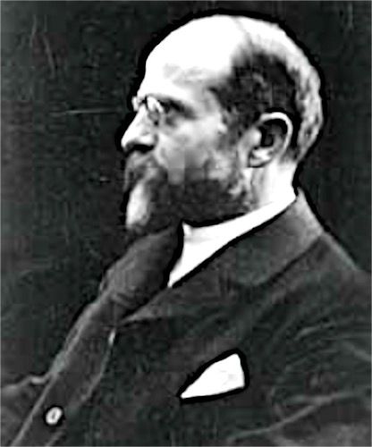
Empathy
Aesthetics
Einfühlung (empathy) T. Lipps Leitfaden d. Psychol. (1903) 187
the power of projecting one’s personality into (and so fully comprehending) the object of contemplation
Empathy:
“the ability to appreciate the other person’s feelings without yourself becoming so emotionally involved that your judgment is affected”
Oxford English Dictionary
Theodor Lipps (1851-1914)
“How’s Your Empathy?,” Reader’s Digest 66 (April 1955): 62-4
Am J Psychiatry 2008; 165: 1261
Notes:
One feeling, in feeling

Slide 29
EMPATHY Has THREE Components
Affective
Cognitive
Behavioral

Slide 30
EMPATHY Has THREE Components
Affective
Visceral Feeling (Modeling)
Observation: People are Contagious

Slide 31
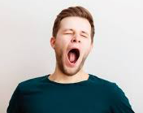
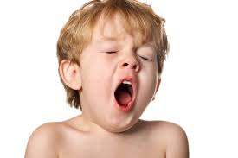
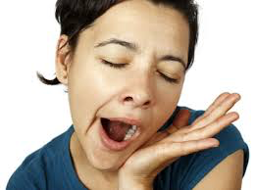
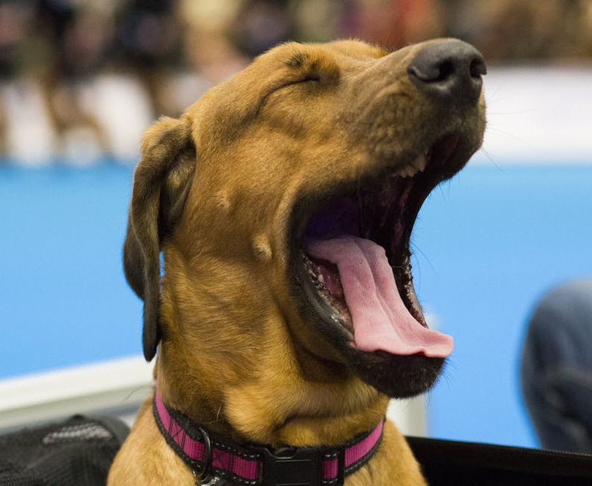
Behavior is Contagious
Notes:
The study of empathy has taken off particularly over the past 15 years or so, beginning with the observation that people are contagious, much more than you would suppose.
This is a highly contagious behavior: someone in the audience will likely do this in the next 20 seconds or so, contagious across people, across species
We can see behaviors spread from one person to another, we say to ourselves why does that happen

Slide 32
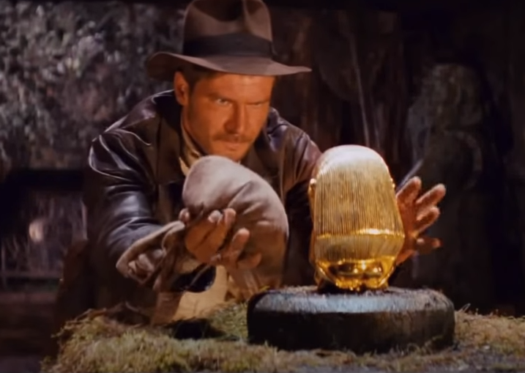
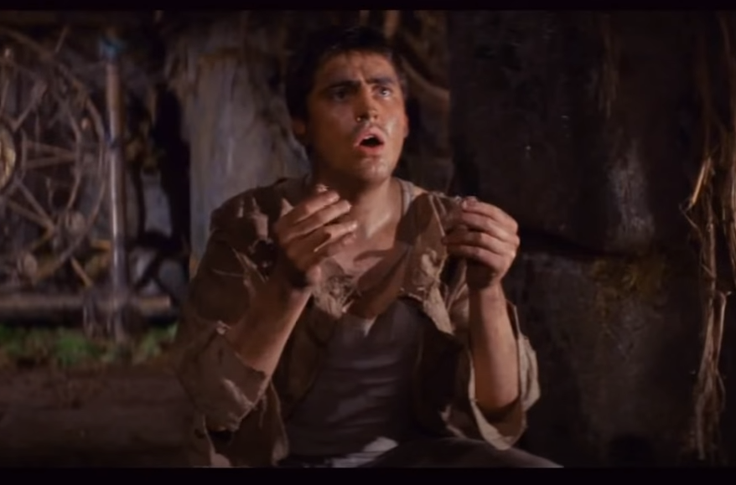
Notes:
Here is another contagious behavior, Indiana Jones, young Alfred Molina as Indie reaches for the headstone
Indie’s behavior is contagious, He stands there going like this, the guy behind that does that. why is that? We will see
Emotional presence is contagious

Slide 33

Notes:
Emotional behavior is contagious. You see someone smiling, you smile, t is difficult to look at this person and not feel happy
That is because emotions are contagions

Slide 34
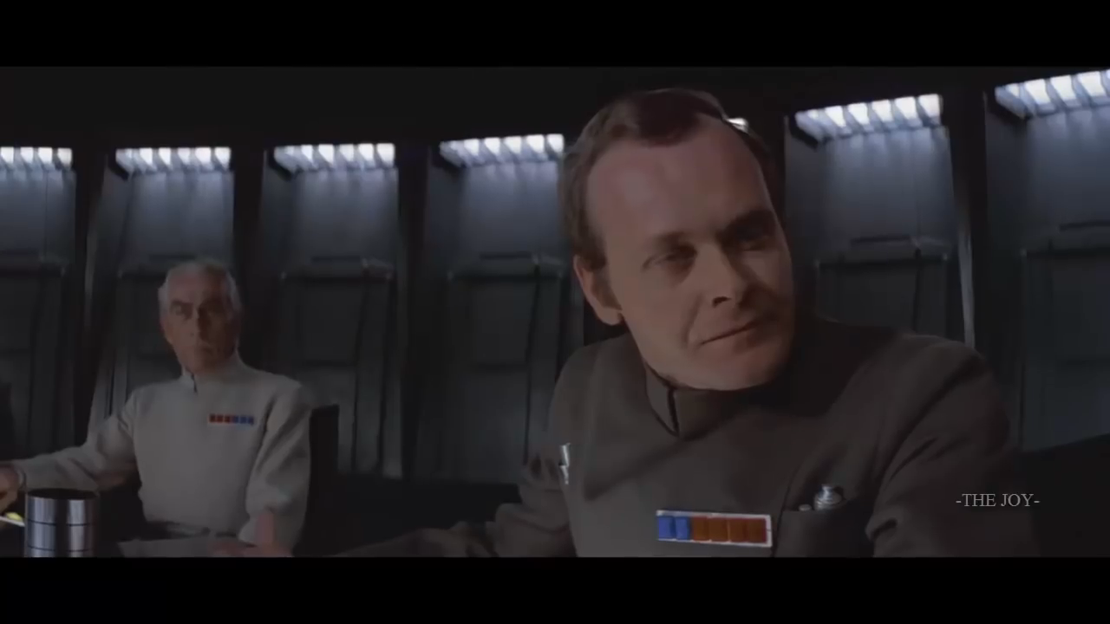
Tone of Voice is Contagious
Notes:
Soo too tones of voice are contagious People who listen to this voice: you can measure that tone of voice becomes deeper when listening Darth Vader

Slide 35
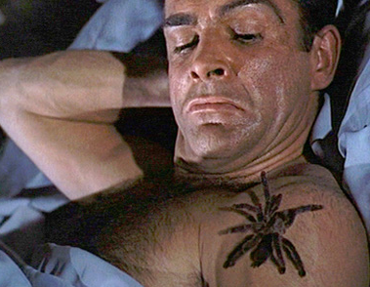
Sensations are Contagious
Notes:
Sensations are contagious, The Dr No effect, a spider crawls up sean connery’s shoulder, people in audience tend to swipe at their own shoulder, creepy feeling, sensations are contagious Before Daniel Craig

Slide 36
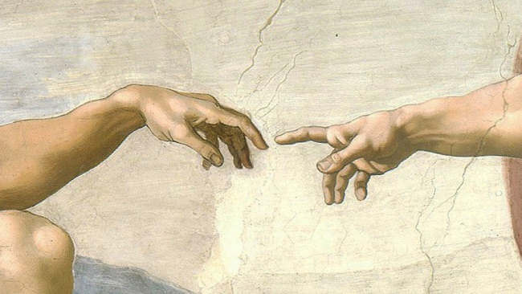
WHY are people
contagious?
Notes:
Why are people contagious, behaviors, emotions, tone of voice sensations contagious, leap from one person to another

Slide 37
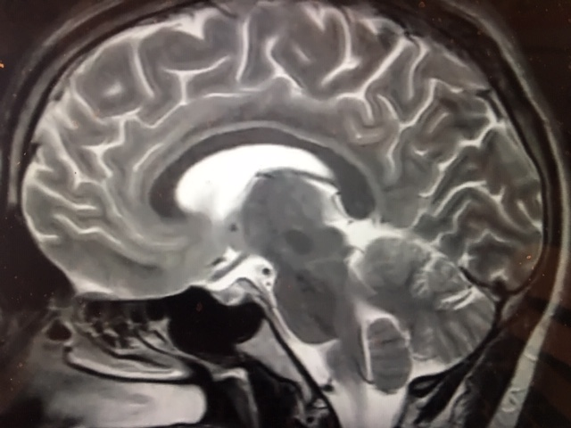
A neuroanatomical perspective
Notes:
300 million years ago, fish, hollow tube ringed with teeth, with large fish growing legs, crawling on to the land

Slide 38
A neuroanatomical perspective
Movement
Heart function
Lung function
Survival reflexes
Brainstem
Cerebellum
Notes:
265 million years ago, the age of the reptiles, rewe find Ancient hardware for making the body run, reuglating heart and lung function, survival refllexs.

Slide 39
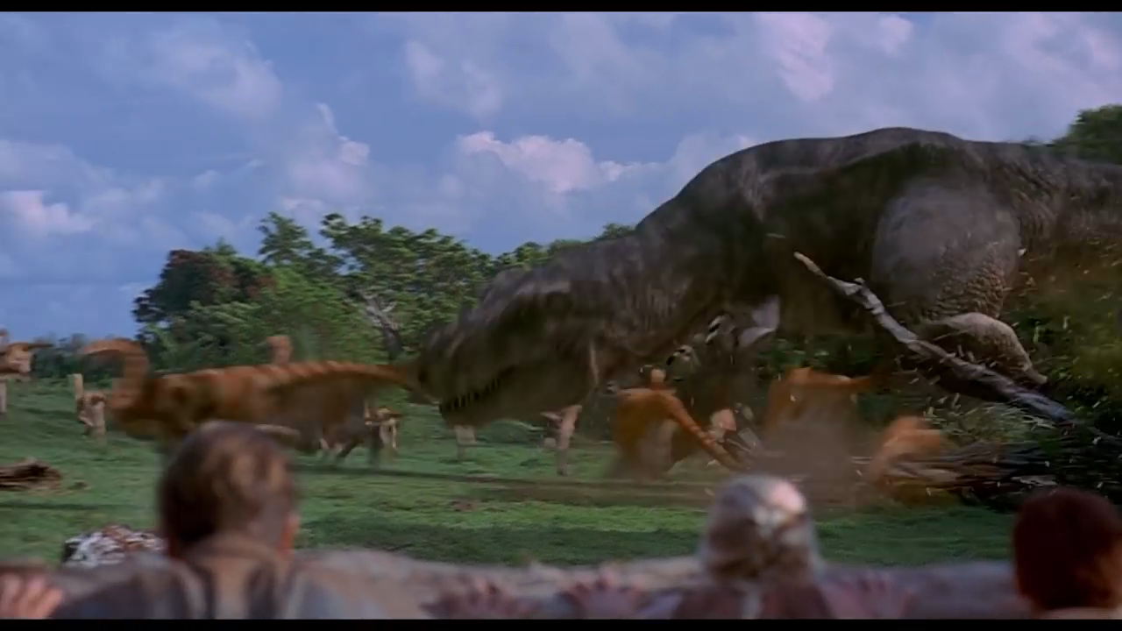
Notes:
There was not a lot of empathy to go around at the time; reptiles don’t have empathy because they don’t need it

Slide 40
A neuroanatomical perspective
Parental bonding
loyalty, affiliation
Parenteral nurturing
protection, care
Cingulate gyrus
Limbic system
Notes:
200 million years ago Mammals evolved at the time Mammalian Brain: cingulate gyrus, limbic system
Mammals arose we see this part of the brain arising because mammals do things, they have qualities and behaviors that reptiles do not: parental bonding, loyalty affiliation, parental nurturing, protection and care, new parts of the brain (Broca, “limbic, lumen, light of empathy, line of distinction between early reptilian and mammalian brain)

Slide 41
A neuroanatomical perspective
Allows us to be “smart”
Symbolic representation
Logic, mathematics
Physics, technology
Invention, imagination
Neocortex
Notes:
Neocortex: just a few million years ago, monkeys, massive neocortex
Smart, symbolic representation, language, logic mathematics, technology, ability to invent, imagine things that have not yet happened

Slide 42
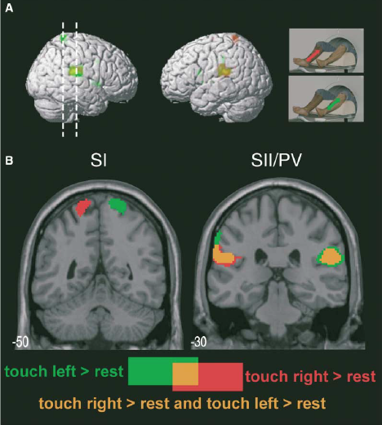
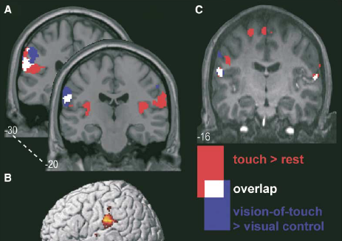
We understand what we see by modeling
(We run an internal model, using the same hardware)
1° / 2° somatosensory cortex
… to a lesser extent
WATCHING someone be touched
BEING touched
Keysers C Neuron 2004; 42: 335-46
Notes:
People stuck in a scanner, one leg and then the other leg is touched, see the primary and then the secondary somatosensory cortex lighting up
Same areas light up when we see someone being touched
People understand what they are seeing by running an internal model: we use a model that uses the same hardware that we would be otherwise used if we were directly experiencing that occurrence
Sometimes we see that modeling leak out (alfred Molina in Indian Jones, he is running a model, and we see it leak out)

Slide 43
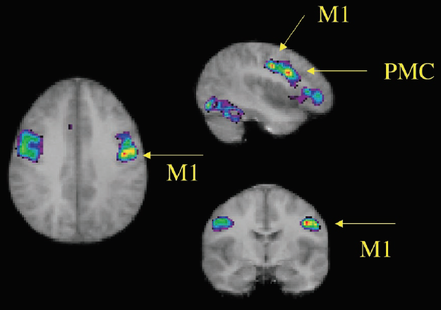
We model emotion
(right central and pre-motor cortex)
Carr L Proc Nat Acad Sci 2003; 100: 5497-502
Notes:
Imaging study seeing someone having an emotion vs having one themselves
Both activate ther right central pre-motor cortex: we model
How we understand

Slide 44
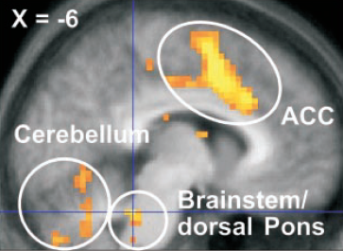
We model pain
(anterior cingulate gyrus)
Mild heat probe directly applied to the calf
Observer
Mild heat probe directly applied to the calf
Singer T Science 2004; 303: 1157-62
Notes:
Singer 2003
People are subject to pain
Probe is applied to the calf, or people watch someone with a probe applied to their calf; This area we know lights up when people have pain. Anterior cingulate cortex (whether you watch someone with pain or you have pain)

Slide 45
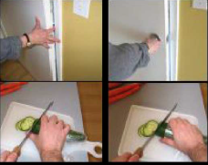
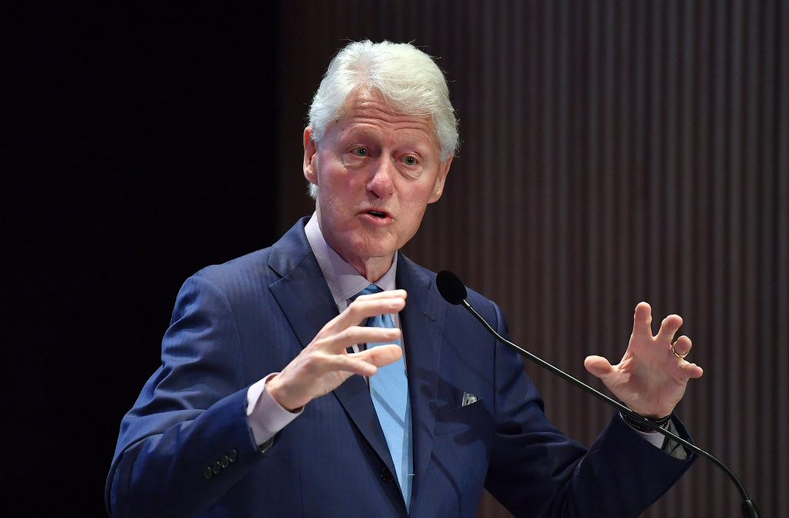
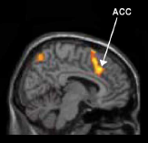
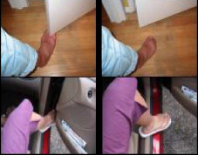
We model pain
(anterior cingulate gyrus)
Pleasant
Unpleasant
Observers feel, experience and understand by creating a model
Jackson PL NeuroImag 2005; 24: 771-9
Notes:
Vivid study of the same phenonmenon. One group shown a non-painful version of the same story.
Observers feel and understand and experience by creating a model. It is unpleasant to even look; not as unpleasant as actually
President Clinton would have modeled

Slide 46
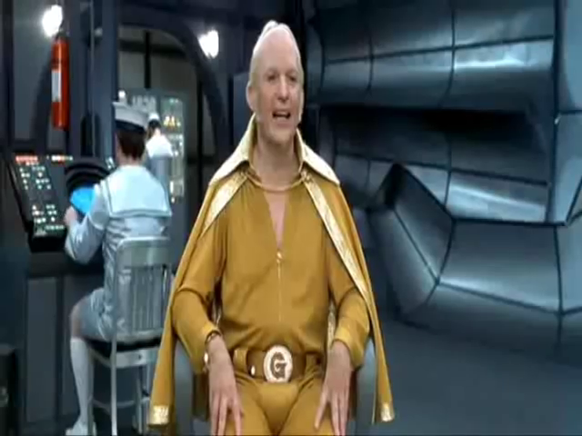
Notes:
AUSTIN POWRS Watch what happens after this fellow is hit in the groin
What do we see happens here. Observers guard their own groins after seeing Dr Evil (Austin Powers) struck in the groin, even the woman holds her groin
Why do they do this? By running a model in their own heads, saying, what if I had been struck in the groin, makes them want to guard themselves
This is why sensations, why people, emotions are contagious

Slide 47
EMPATHY Has THREE Components
Affective
Cognitive
Behavioral
Objectively understanding
Moving from self-orientated to other-orientated

Slide 48
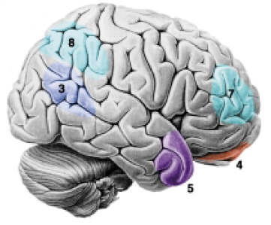
Notes:
Projection of point of view away from ourselves, send out a scout and look at the world from a different point of view

Slide 49
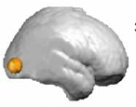
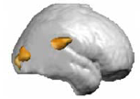
Body Location ≠ Self Location
Arzy S J of Neurosci 2006; 26: 8074-81
Notes:
Arzy 2002
You wouldn’t necessarily think that we would have a portion of our brain that can project, imagine what it would be like looking back from another point of space,, including our own body

Slide 50
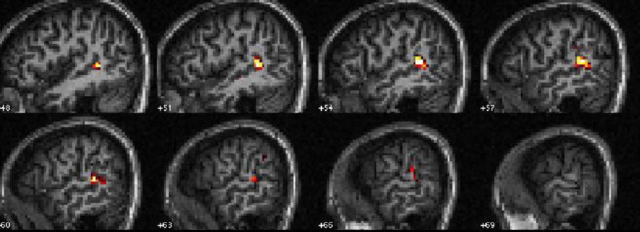


We “other orient” to an intentional act
Saxe R Neuropsychologia 2004; 42: 1435-46
Notes:
This part called upon w empathy. Saxe 2004

Slide 51
We “other orient” to an intentional act
Saxe R Neuropsychologia 2004; 42: 1435-46
Notes:
Saxe 2004

Slide 52
We “other orient” to an intentional act
Saxe R Neuropsychologia 2004; 42: 1435-46
Activation of the posterior-superior temporal sulcus
Notes:
Saxe 2004: Projection of our point of view from the posterior superior temporal sulcus
You send your point of view behind the bookcase. Projection behind the bookcase

Slide 53

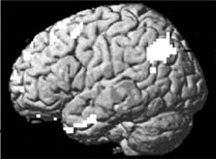

We “other orient” to imagined intention
Activation of the posterior-superior temporal sulcus
den Ouden HMS NeuroImage 2005; 28: 787-96
Notes:
Imagine tree falling, nothing lights up
Ask to imagine an intentioned action, someone standing in front of you
Posterior superior temporal focus
Why are they doing what they’re doing, whatdo they see, do they know that they’re blocking me

Slide 54

We “other orient” to intended emotion
“Theory of Mind”
Activation of the posterior-superior temporal sulcus
despondent relieved
shy excited

Slide 55
EMPATHY Has THREE Components
Affective
Cognitive
Behavioral
Empathy without ACTION is not therapeutic
Halpern J. From Detached Concern to Empathy: Humanizing Medical Practice. New York: Oxford University Press, 2001
Derksen F. Br J Gen Prac 2013; 63: 76-84.
Decety J. Introduction. In: Decety JHS (ed.) Empathy: from bench to bedside. Cambridge, MA: MIT Press, 2011, vi-ix.
Notes:
Jodi Halpern
Frans Derksen
Jean Decety

Slide 56
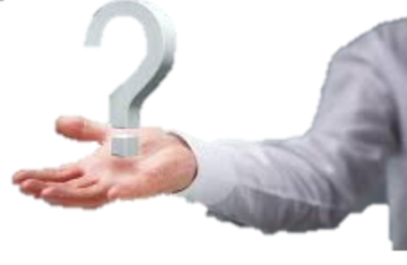
Two SIMPLE PHRASES extend understanding
“What else?”
More possibilities
“Tell me more”
Greater depth of detail

Slide 57
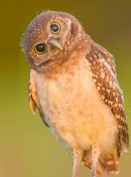
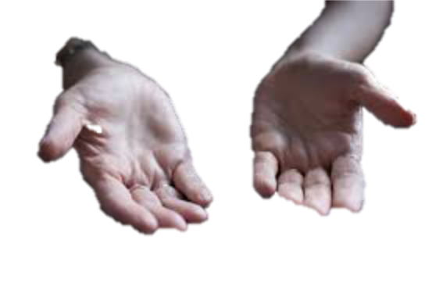
CURIOSITY helps to engage and to avoid assumption
Keep your head clear
Partial head tilt
Open posture
Eye contact
Mild lean in
Arms uncrossed and open

Slide 58
Behavioral empathy is a learned and practiced skill
Name the emotion
Understand the emotion
Respect (praise) the patient
Support the patient
Explore the emotion
S: face the patient Squarely
O: adopt Open body posture
L: Lean towards the patient
E: use Eye contact
R: keep body posture Relaxed
Name the emotion
Understand the emotion
Respect (praise) the patient
Support the patient
Explore the emotion
Eye contact
Muscles of facial expression
Posture
Affect
Tone of voice
Hearing
Your response
Eye contact
Muscles of facial expression
Posture
Affect
Tone of voice
Hearing
Your response
Tulsky JA. Ann Int Med 2011; 155: 593-601.
Riess H. J Gen Intern Med 2012; 27: 1280-6.
Notes:
Soler (“to usually do”) Helen Reiss, The Empathy Effect (2018) (perception and action)
Tested in RCT’s (SCOPE 2011 James Tulsky, Riess et al 2012)

Slide 59
Therapeutic empathy is a BIDIRECTIONAL
efferent
afferent
Relationship
adapted in part from Riess H. The Empathy Effect. Boulder, CO: Sounds True, 2018.
Notes:
Helen Reiss, The Empathy Effect (2018) (perception and action)

Slide 60
EMPATHY
Affective
Cognitive (distinct)
Behavioral (skilled)
Imaginative/reflect
Action
Reactive distress
SYMPATHY
Experiential
Reactive
Self-oriented
Egoistic
Pitty / sorrow
Increased suffering
COMPASSION
Awareness
Desire to relieve
≠ Reflective
≠ Understanding
≠ Action / helping
Increased suffering
Processing and taking action allows us to empty our own internal “stress buckets”
Jeffrey D. J R Soc Med 2016; 109: 446-52.

Slide 61

Empathy has a “spot light” effect
Near field bias
Short-term bias
Tribal bias
Bloom P. Against Empathy: The Case for Rational Compassion. New York: HarperCollins, 2016
Singer T, Lamm C. Ann NY Acad Sci 2009; 1156: 81-96.

Slide 62

Empathy can be “morally corrosive”
Connection with a person can shift perspective on a more global moral dilemma
Krause KW, Döhring H, Plain A. Living with Hitler: Accounts of Hitler’s Household Staff. S Yorksire, UK: Greenhill Books, 2018
Bloom P. Against Empathy: The Case for Rational Compassion. New York: HarperCollins, 2016

Slide 63

Medical Empathy is Foucaldian
“Pastoral Power”
The care provider helps the patient ‘confess’ their story, allowing complicity with therapy and healing (and exercising / displaying the clinician’s virtue)
Mayes C. J Bioethical Inq 2009; 6: 483-93
Hooker C. Med Health Care Philos 2015; 3: 1-12
Notes:
Paul Michel Foucault

Slide 64


Empathy can be morally “neutral”
Sociopaths, con men, seducers, torturers and bullies all score high in cognitive empathy
… ‘Do you remember writing in your diary… that it did not matter whether I was a friend or an enemy, since I was at least a person who understood you and could be talked to? `
…There was no idea that he had ever had, or could have, that O'Brien had not long ago known, examined, and rejected. His mind contained Winston's mind…
Bloom P. Against Empathy: The Case for Rational Compassion. New York: HarperCollins, 2016
Orwell G. 1984. London: Secker and Warburg, 1949
Notes:
Richard Burton (O’Brien), John Hurt (Winston Smith) Caligula, I Claudius, Room 101

Slide 65
SUFFERING

Slide 66

Notes:
2017 Greatest showman Hugh Jackman Keala Settle

Slide 67

UT Southwestern MGR 2026
Notes:
Hunter Doherty Patch Adams

